Slide 1
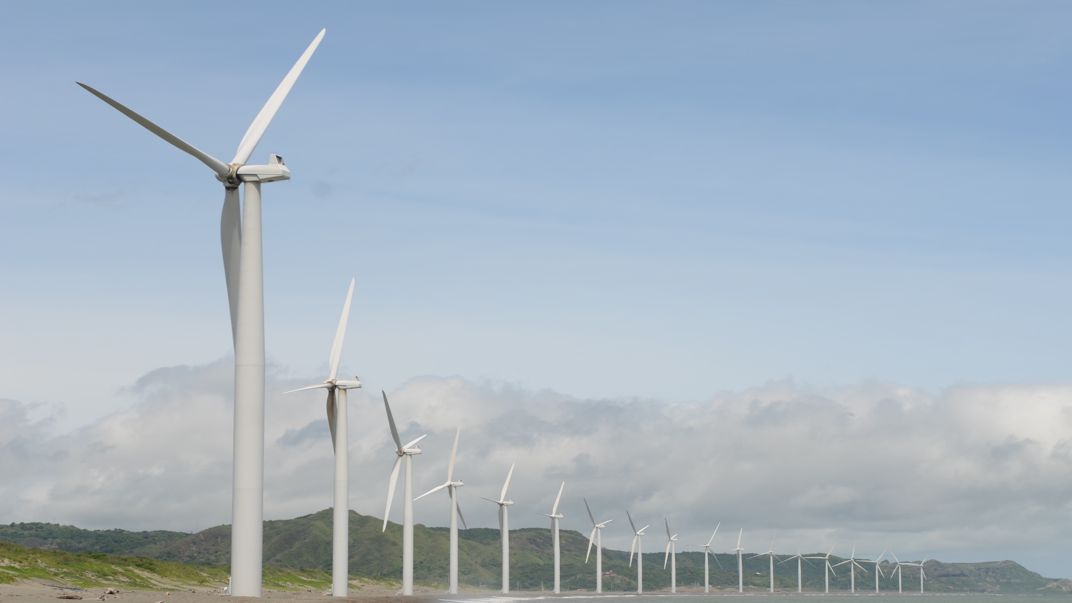
Wind Turbine
Energy

Slide 2
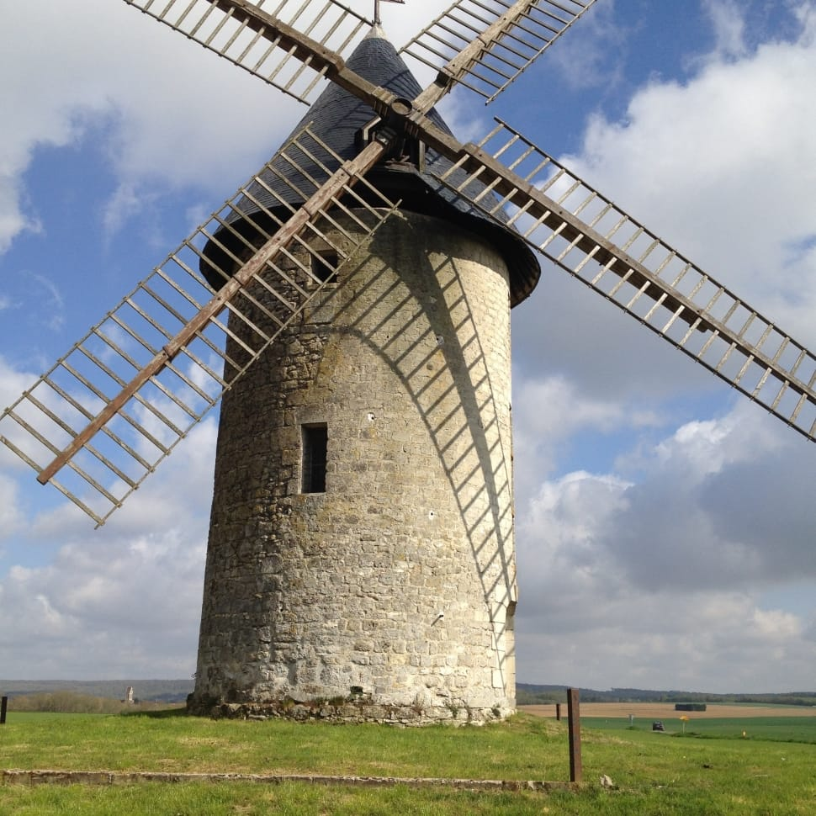
HISTORY
The first wind-mills were developed in Persia and probably in Chaina between 500-900 B.C to automate the tasks of water-pumping and grain grinding .
From there the use of wind-mills spread from Persia to the surrounding areas in the middle east , where it was used in food production.
Around 1,000 A.D., wind power technology spread north to European countries such as The Netherlands, which adapted windmills to help drain lakes and also to grind grain, with a new design for the wind mill – a tower mill.
The technology developed between 1850 and 1970, over six million mostly small (1 horsepower or less) mechanical output wind machines were installed in the U.S. alone.

Slide 3
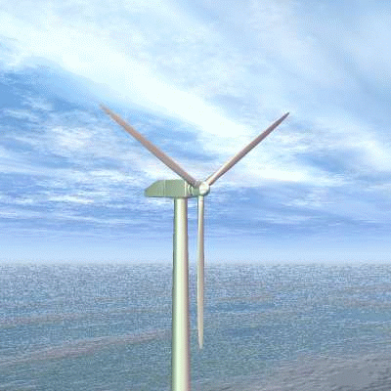
INTRODUCTION
Wind turbine is a device that converts kinetic energy from the wind into electric power.
Wind energy is created when the atmosphere is heated unevenly by the Sun, some patches of air become warmer than others. These warm patches of air rise, other air rushes in to replace them thus, wind blows.
It works opposite of fan turbine blade spin from the wind and make energy instead of using energy to make wind.
The first windmill used to produce electric energy was created in 1888 by Charles F. Brush.
The wind power programme in India was started during 1983-84 with the efforts of the Ministry of Non-Conventional Energy Sources.

Slide 4

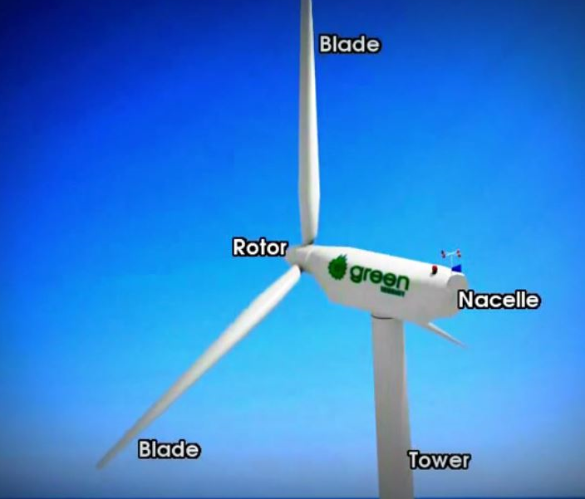
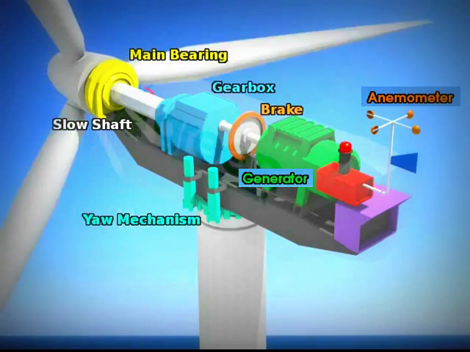
Components of wind turbine

Slide 5
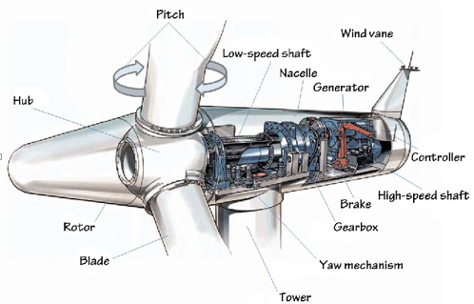
Function of Component
Foundation: Foundation give support to wind turbine. It consist of solid concrete assembly
Tower : It connect rotor and foundation and raise rotor so that it can operate at required wind. Made up of steel having tube like structure.
Rotor & Rotor blades : It is rotating part which converts wind energy to rotation. It is made up of glass-fibre, carbon-fibre, reinforced plastics.
Nacelle : Contains the key components of the wind turbine including the gearbox , yaw system and electric generator
Low speed shaft: Connects the rotor hub to the gearbox.
High speed shaft : Drives the electrical generator by rotating at high speed.

Slide 6
Function of Component
Gearbox :- The gearbox converts the rotor motion of lower rpm into the higher rpm.
Coupling :- Coupling is done between the main shaft and the transmission.
Generator :- Generates electricity from rotation of shaft.
Controller :- It is a self operating system use in control system. It may be sensor (mechanical, electrical),
decision elements( relays, microprocessor) and actuators( hydraulic, electric).
Yaw mechanism :- Turns the nacelle with the rotor into the wind using motors.
Anemometer and wind vane :- Measures the speed and the direction of the wind while sending signals to
the controller to start or stop the turbine.

Slide 7
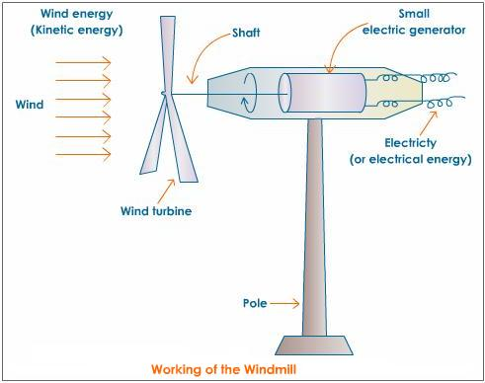
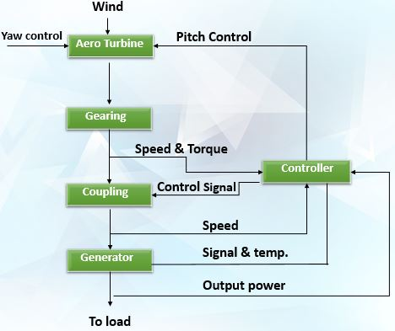
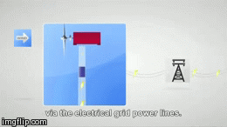
Working

Slide 8

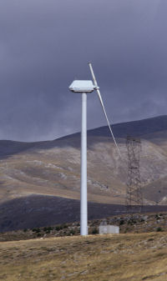

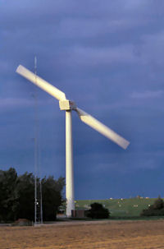

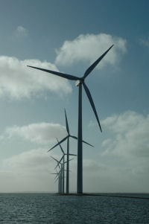
Types of wind turbine
Horizontal axis type
A horizontal axis machine has its blades rotating on an axis parallel to the ground.
Single blade Horizontal wind turbine | Two blades Horizontal wind turbine | Three blades Horizontal wind turbine
Lower blade weight and less cost.
Similar to single blade HAWT.
Balance of gyroscopic forces
More vibration & unconventional look.
Have stability problem
increases gearbox costs

Slide 9
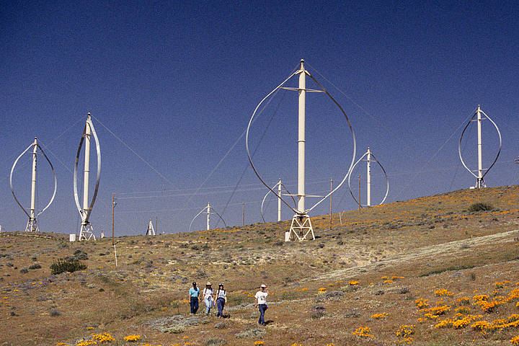
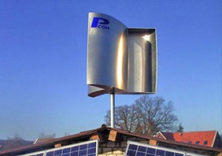
Types of wind turbine
Vertical axis type
Vertical axis wind turbines(VAWTs) have the main rotor shaft arranged vertically.
VAWTs runs in any wind direction.
Darrieus wind turbine | Savonius wind turbine
Good efficiency
drag type turbine
Produce large torque and cyclic stress on the tower
used in cases of high reliability in many things such as ventilation and anemometers.
Require some external power source to start turning
self starting
less efficient

Slide 10
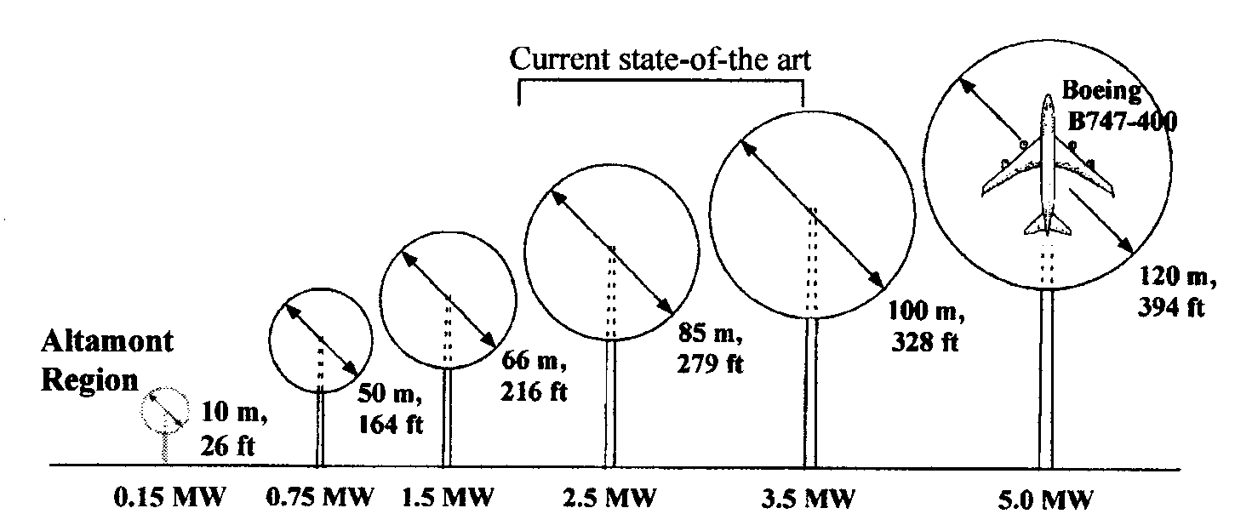
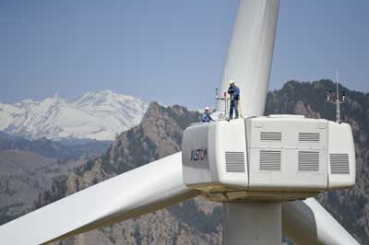
Size of wind turbine
Small (≤10 kW)
Homes
Farms
Remote Applications
(e.g. water pumping, telecom sites,)
Intermediate
(10-250 kW)
Village Power
Hybrid Systems
Distributed Power
Large (250 kW - 2+MW)
Central Station Wind Farms
Distributed Power

Slide 11
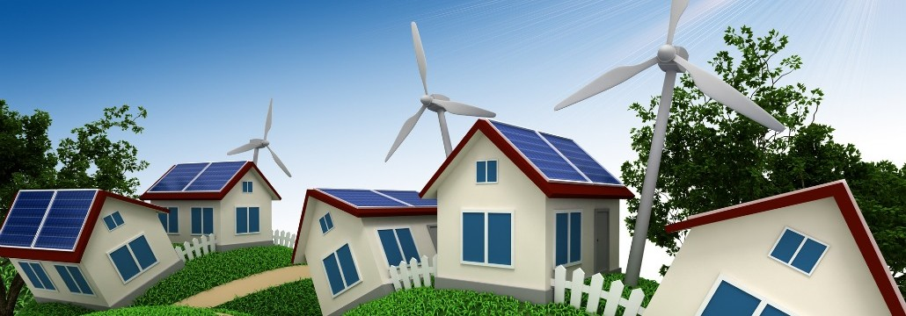
Small scale wind turbines
Are they worth it, energy-wise?
Energy and Sustainability
Notes:
Wind power was very popular in the search for renewable energy sources, it is quite developed.
What was interesting to me was to see what will happen if we use small scale wind turbines in our homes. What will be the influence.
No cover for financial information

Slide 12
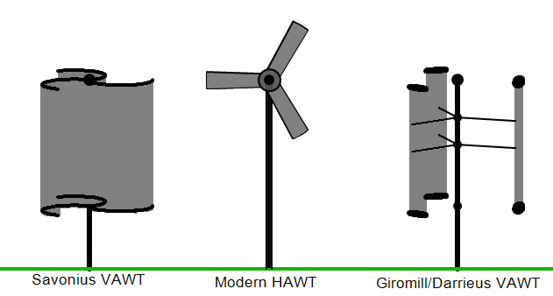
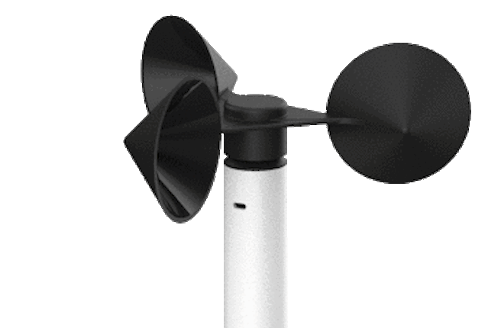
Types of small-scale wind turbines
Horizontal axis wind turbine (HAWT)
Vertical axis wind turbine (VAWT)
Anemometer
Notes:
The most common type in the UK is the HAWT [Bahaj et al., (1)]

Slide 13
HAWT
Types of small-scale wind turbines
VAWT
Main rotor shaft arranged vertically
The generator and gearbox can be placed near the ground
Does not need to be pointed into the wind
Relatively low rotational speed
Main rotor shaft and electrical generator at the top of the tower
Must be pointed into the wind
Notes:
Most of the small scale (and in general) wind turbines are horizontal axis – more efficient, usually
Most early ones – vertical
In Europe - horizontal

Slide 14

Gross power small scale wind turbines
$$P_{G}=\frac{1}{2}ρAu^{3}e$$
$A=\frac{π}{4}D^{2}$
$D$ – rotor diameter
$ρ$ – air density
$u$ – wind velocity
[Sahin et al. 2006]
Notes:
Wind turbine - a device that converts kinetic energy from the wind into electrical power.
U (cubic) and D (square) are the dominant factor
Has cubic dependence on wind velocity

Slide 15
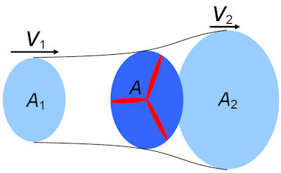
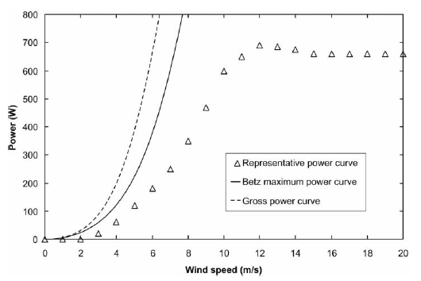

Betz limit - Max power of $59\%$
Power limit small scale wind turbines
[Betz 1946]
Notes:
16/27 or 59% of the Gross power. Betz's law calculates the maximum power that can be extracted from the wind.
Real turbine extract less than Betz limit due to aerodynamics and power conversion losses.
Figure: representative micro-wind turbine power curve, compared with the Gross power and the Betz limit.

Slide 16
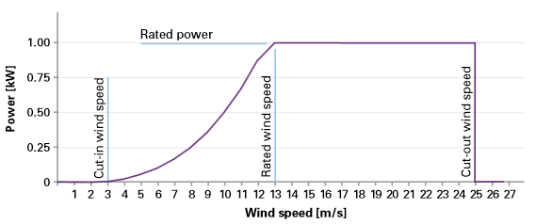
Power curve small scale wind turbines
[Entec]
Notes:
Entec – a company that de sign environmental solutions and products
http://www.entec-international.com/
Cut-in speed: At very low wind speeds, there is insufficient torque exerted by the wind on the turbine blades to make them rotate
Rated power: the power output reaches the limit that the electrical generator is capable of – keep the power at const level
Cut-out speed: There is a risk of damage to the rotor

Slide 17
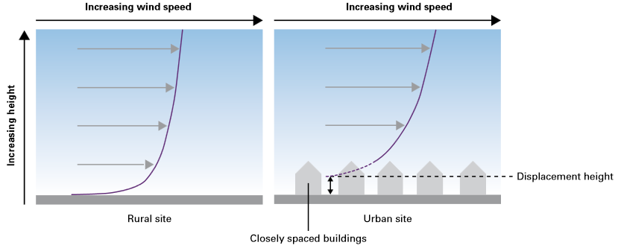
Wind resource small scale wind turbines
[Entec]
Notes:
Globally, winds are caused by pressure gradients generated by the differential heating of the Earth’s surface by the Sun
Within the atmospheric boundary layer the shear stresses caused by the Earth’s surface extract momentum from the wind,
and cause a variation of velocity with height. Topography,surface roughness etc.
Urban environments typically have the greatest surface roughness, and climatological processes in such environments are accordingly complex.

Slide 18
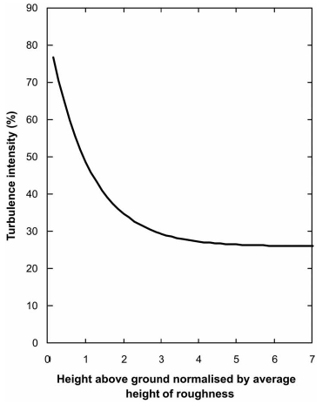
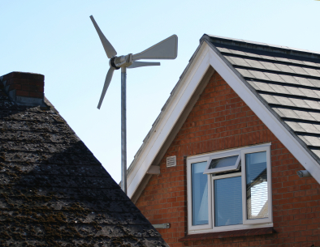
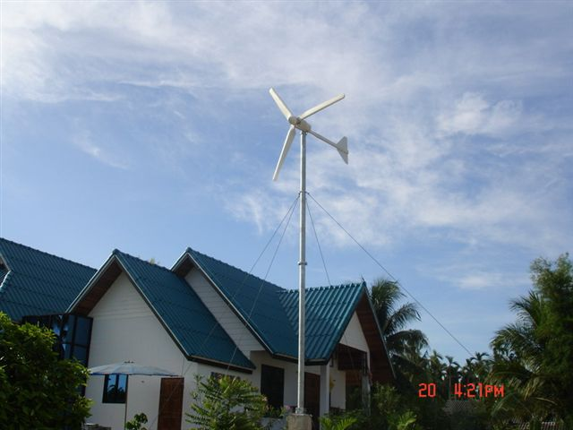
Turbulence small scale wind turbines
Rated power of less than 50kW
[Roth, 2000]
Notes:
Turbulence intensity as a function of height in urban environments

Slide 19
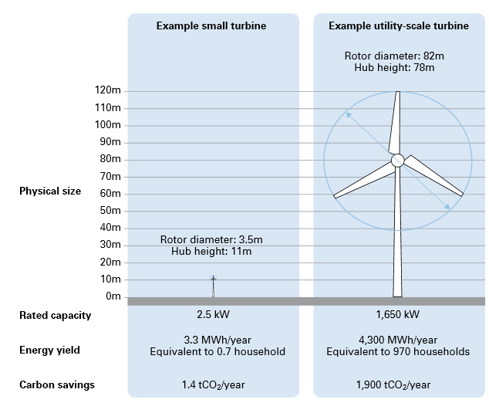
Comparison small scale wind turbines
 | micro HAWT | Swift rooftop wind turbine
Power rating (kW) | 0.6 | 1.5
Mean annual output (kWh) | 870-164 | 2000 - 3000
Rotor diameter (m) | 1.7 | 2
Lifetime (y) | 15 | 20
Rated velocity (m/s) | 12 | 12
[Carbon trust]
Notes:
1650/2.5 = 660
4300/3.3 = 1303
1900/1.4 = 1360

Slide 20
The performance of wind turbines depend on 5 major factors:
WIND POWER
OBSTRUCTIONS
ALTITUDE
AIR
TEMPERATURE
BLADE
AERODYNAMICS

Slide 21
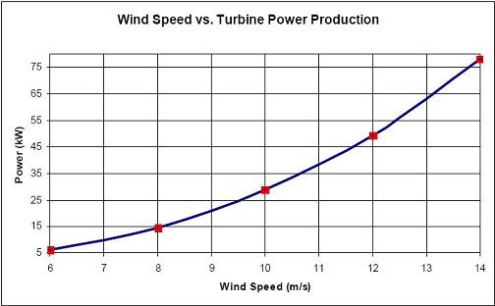
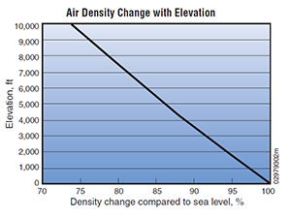
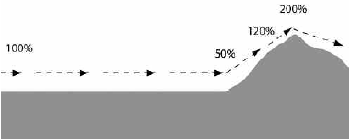


Site Selection
Consideration during site selection
High annual average wind speed
Altitude of proposed site
Terrain and aerodynamic
Ease of transportation
Nearness to users/centers
Local ecology & Nature of ground
Best sites for wind turbine
Off shore and sea coast (2400 kWh/$m^{2}$ per year)
Mountains (1600 kWh/$m^{2}$ per year)
Planes (750 kWh/$m^{2}$ per year)

Slide 22
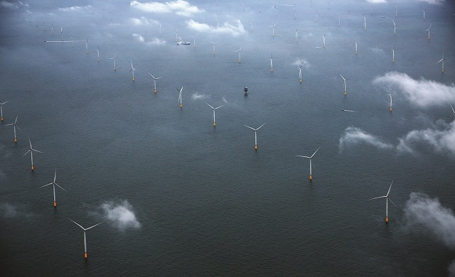
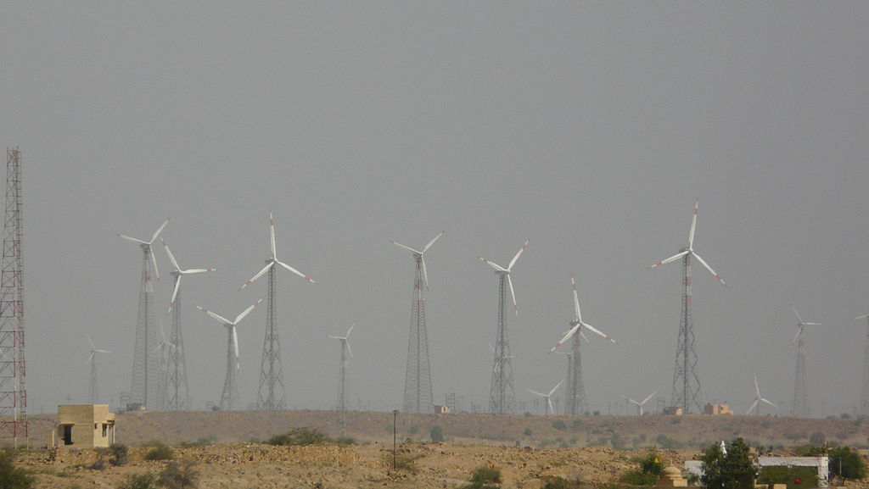
Wind farms
A wind farm or wind park is a group of wind turbines in the same location used to produce energy.
Offshore wind farms
Onshore wind farms
Wind farm located right off the
coast or in sea using floating platform.
Less wind power available than offshore.
Less cost in installation.
More wind power but more cost.
Usually near to user but create noise and visual problems.
London Array, United Kingdom (630 MW)
Jaisalmer wind park, Rajasthan (1064 MW)

Slide 23
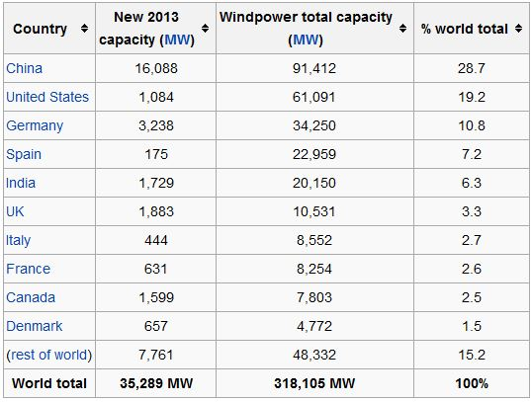
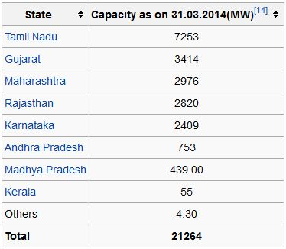
Location of wind farm
Worldwide there are now over two hundred thousand wind turbines operating, with a total nameplate capacity of 318,105 MW.
Top 10 countries by nameplate wind power capacity
wind energy installations in states across India

Slide 24
Safety System
Emergency stop :- If a situation arises which calls for the wind turbine to be stopped immediately, it is
used and wind turbine stop in few seconds by feathering the blade directly into the wind.
Computer and sensors :- The wind turbine is controlled by a computer and data from sensors
which monitors the most important gauging instrument and compare the result , if
found error wind turbine is stopped.
Lightning Rods :- The wind turbine system is protected from lighting by these rods going from the tip
of the blade to the ground.
Temporary Rope System :- This system provides temporary fall protection during construction,
maintenance or inspection of wind turbine.

Slide 25
ADVANTAGE
Cost comparison of different sources
Power plant type | Cost ($/kW-hr) | Renewable sources
Natural gas | 0.07-0.13 | No
Hydro | 0.08 | Yes
Coal | 0.08-0.14 | No
Wind | 0.08-0.15 | Yes
Nuclear | 0.10 | No
Biomass | 0.10 | Yes
Solar PV | 0.13 | Yes
Good for environment as it uses renewable source of energy as wind.
Wind is freely available in nature.
Can be setup in remote areas where electricity through transmission wire cannot be reached.
Clean source of energy as it does not produce any green house gases or any other pollutants.
Once setup is completed the cost of generation electricity become less.
Can be combined with solar electricity to give reliable supply of electricity.

Slide 26
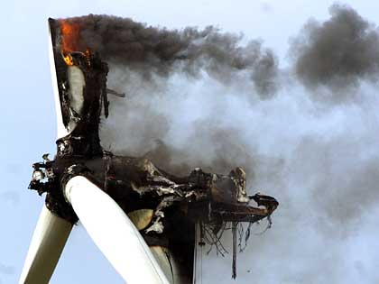
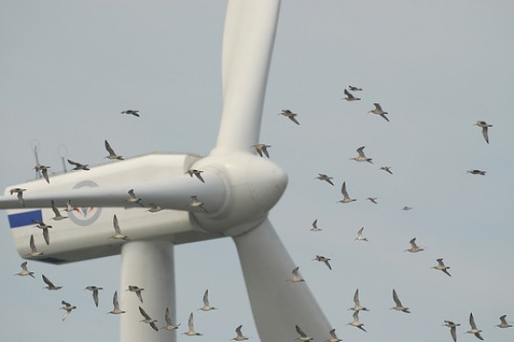
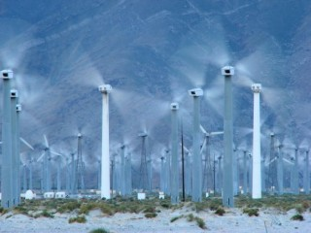
DISADVANTAGE
Site Specific i.e suited to particular region.
Create a lot of Noise Disturbances
Prediction of wind is difficult i.e wind speed varies.
Threat to wild life as it kills birds.
Cause visual impact.
High Initial cost.
Large requirement of land for wind farm.
Turbines Interfere With the Reception of Televisions and communication signals.

Slide 27
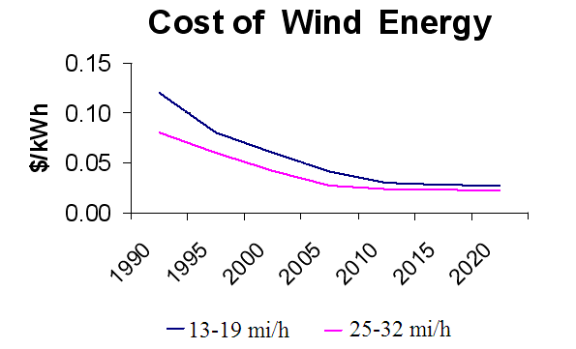
Future
Wind farms can provide a surplus of reliable clean energy to society.
Wind alone can not solve today’s energy crisis in one day, but together with many other forms of renewable power, maybe someday we can help relieve the damage to our planet caused by the overconsumption of fossil fuels.
Price of wind power is coming down.
Technological Developments as application specific Turbines
Offshore
Limited land/resource areas
Transportation or construction limitations
Low wind resource
Cold climates
Can become cost competitive for electricity generation if fossil energy costs skyrocket.

